Slide 1
K-means clustering

Slide 2
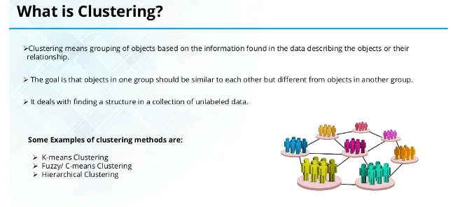

Slide 3
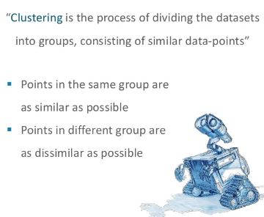

Slide 4
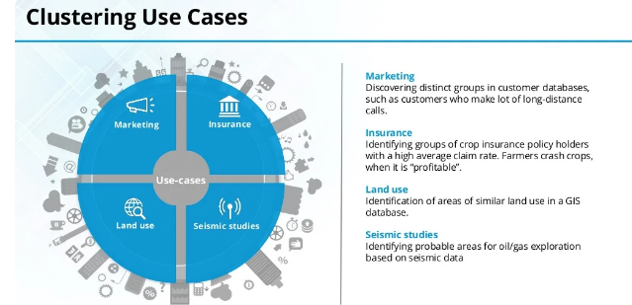

Slide 5
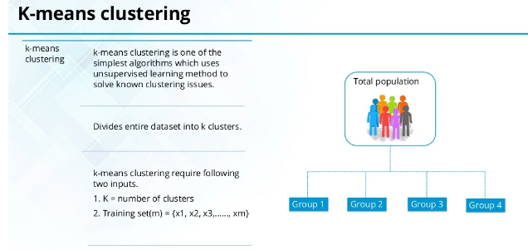

Slide 6
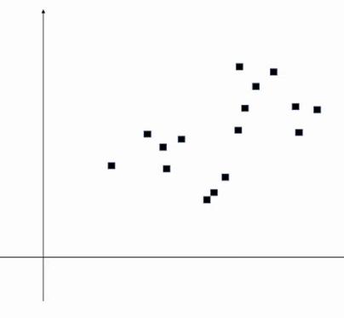
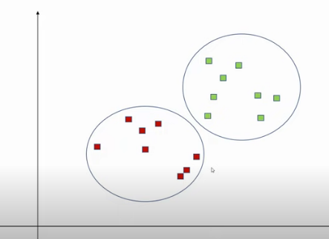

Slide 7
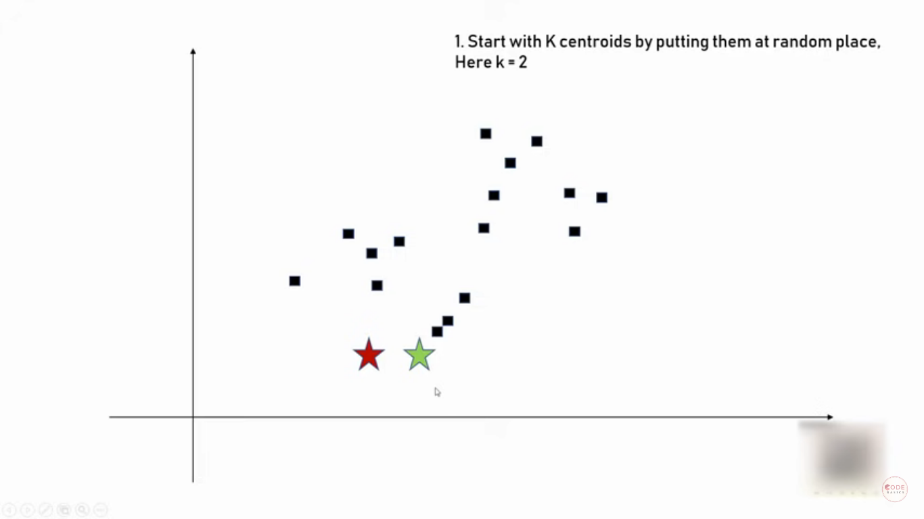

Slide 8
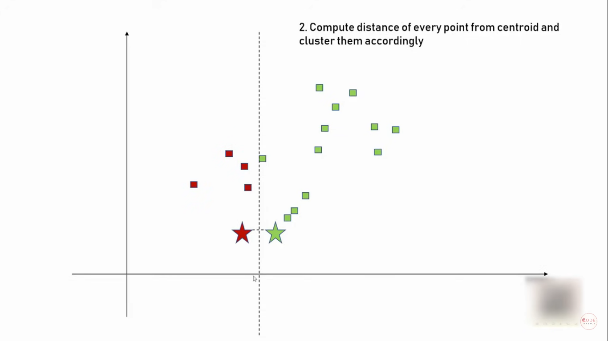

Slide 9
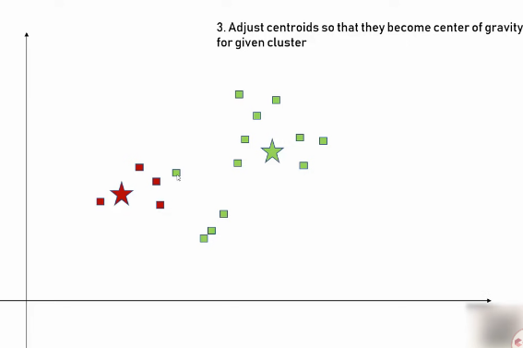

Slide 10
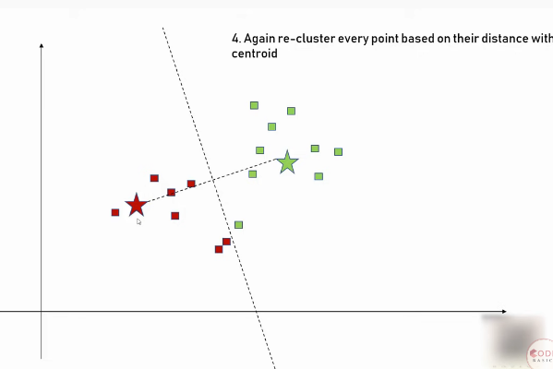

Slide 11
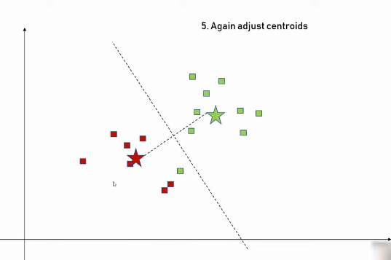

Slide 12
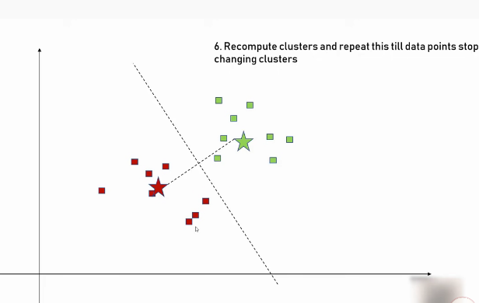

Slide 13
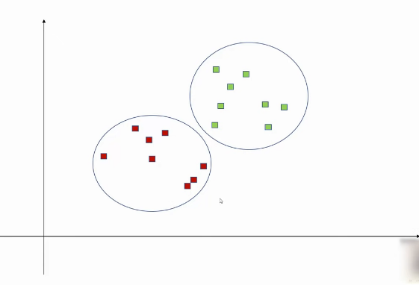

Slide 14
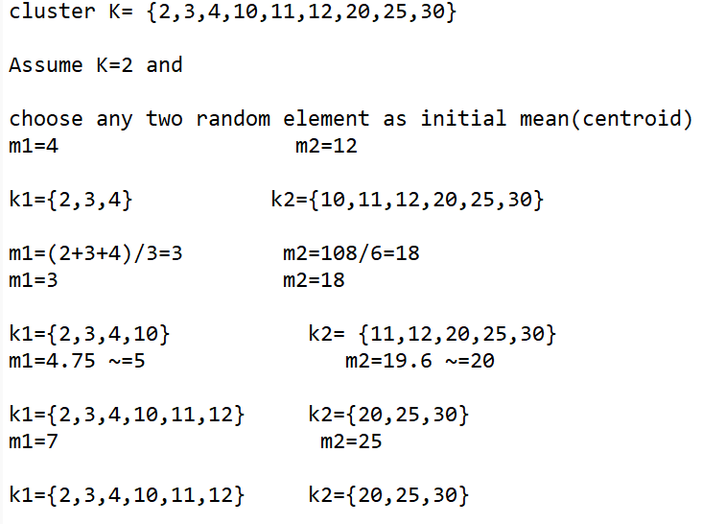

Example 1
Since we getting the same mean again , we can stop now

Slide 15
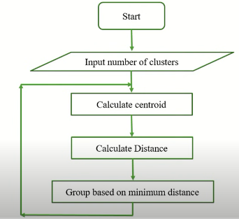
Algorithm
Step 1: Take/Assume Mean value (Random)
Step 2: Find Nearest Number of Mean and them in Cluster
Step 3: Repeat Step 1 and 2 until we get same mean;

Slide 16
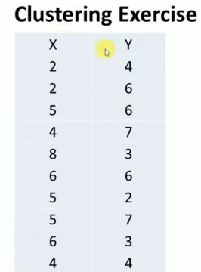
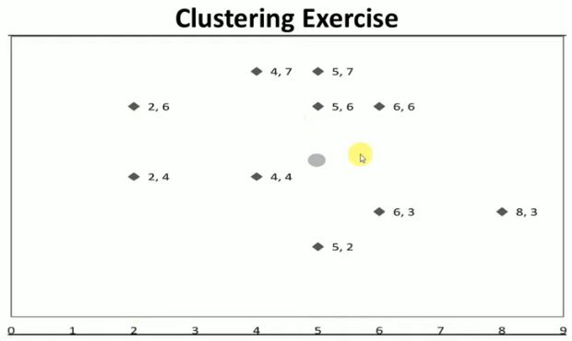

Slide 17
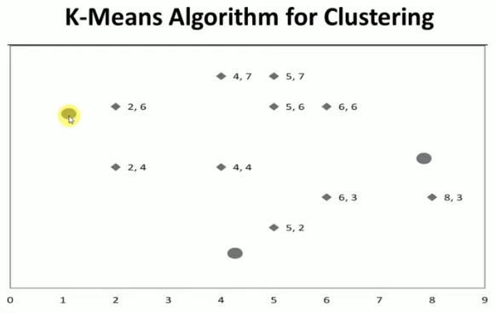
Randomly choose the centroid

Slide 18
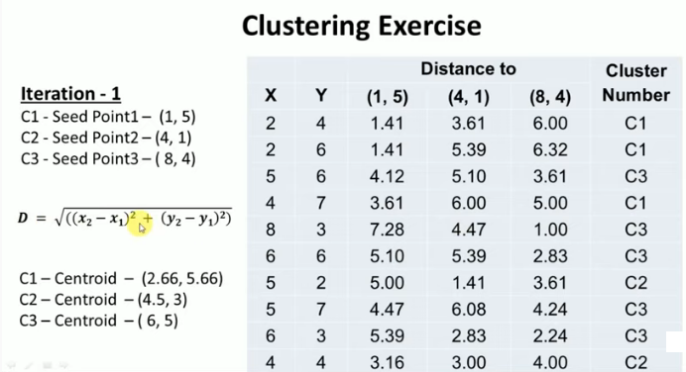

Slide 19
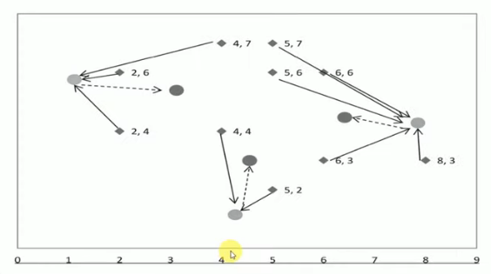

Slide 20
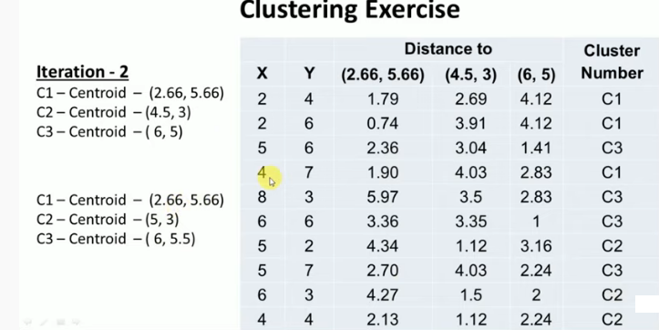

Slide 21
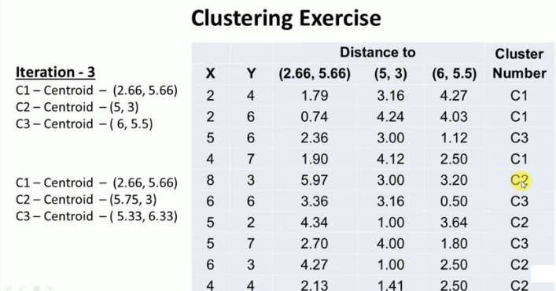

Slide 22
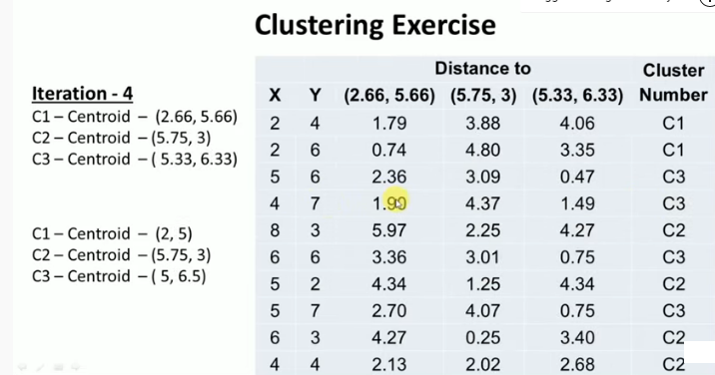

Slide 23
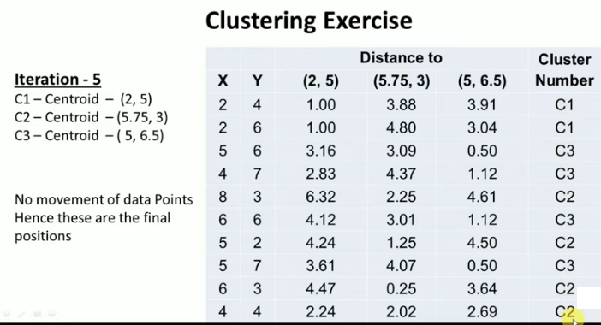

Slide 24
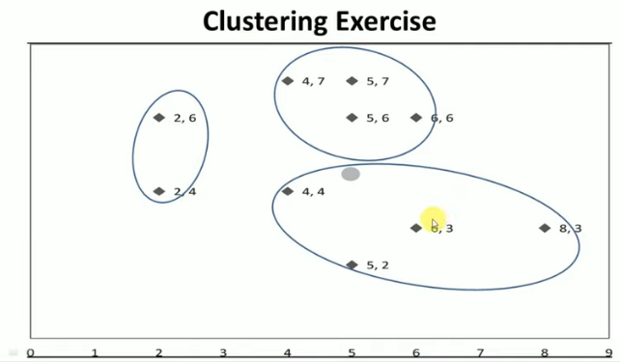

Slide 25
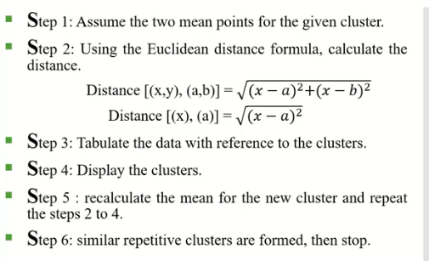

Slide 26
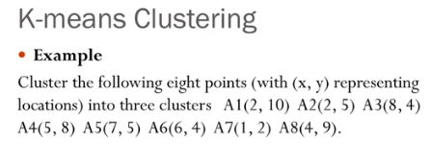

Slide 27
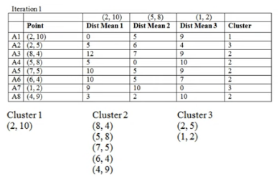

Slide 28
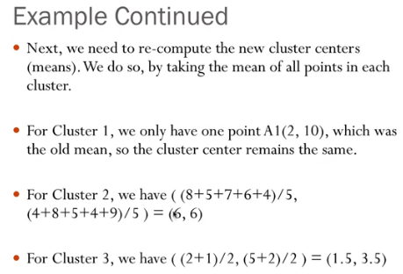

Slide 29
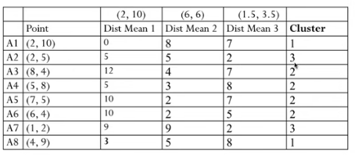
Iteration -2

Slide 30
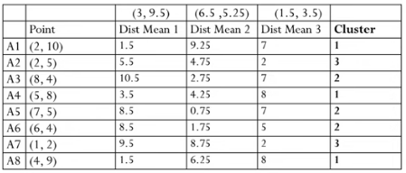
Iteration 3

Slide 31
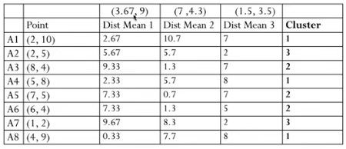
Iteration 4

Slide 32
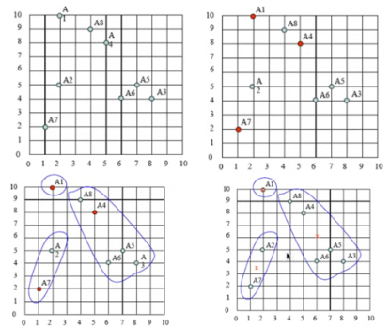

Slide 33
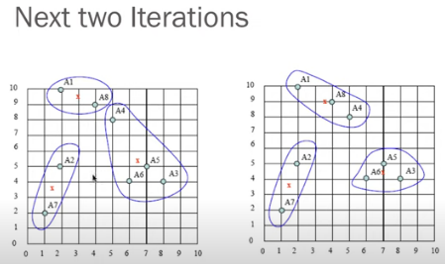


Slide 34
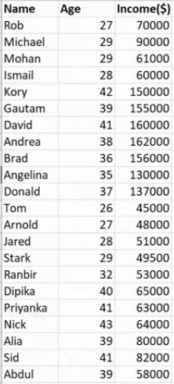
TRY IT OUT…

Slide 35
Problem
Consider eight data points with two dimensions X and Y as candidates. Find three clusters using the k means algorithm.
 | X | Y
P1 | 1 | 1
P2 | 6 | 7
P3 | 4 | 6
P4 | 5 | 7
P5 | 5 | 2
P6 | 2 | 3
P7 | 1 | 2
P8 | 3 | 1

Slide 36
Step 1
No. of clusters = 3 (i.e.) K = 3

Slide 37
Step 2
Find the centroid
Initial Seeds:
Seed1(P1)=(1,1)
Seed2(P4)=(5,7)
Seed3(P7)=(1,2)

Slide 38

Step 3
Find the distance between objects (points) and centroids using Manhattan distance
Data points | Distance with seed1 (P1) (1,1) | Distance with seed2 (P4) (5,7) | Distance with seed3 (P7) (1,2)
P1(1,1) | 0 | 7.211 | 1
P2(6,7) | 7.8 | 1 | 7.07
P3(4,6) | 5.831 | 1.414 | 5
P4(5,7) | 7.211 | 0 | 6.4
P5(5,2) | 4.1231 | 5 | 4
P6(2,3) | 2.23 | 5 | 1.414
P7(1,2) | 1 | 6.4 | 0
P8(3,1) | 2 | 6.32 | 2.23

Slide 39
Step 4
Grouping based on minimum distance
Data points | Distance with seed1 (P1) (1,1) | Distance with seed2 (P4) (5,7) | Distance with seed3 (P7) (1,2) | Cluster No
P1(1,1) | 0 | 7.211 | 1 | I
P2(6,7) | 7.8 | 1 | 7.07 | II
P3(4,6) | 5.831 | 1.414 | 5 | II
P4(5,7) | 7.211 | 0 | 6.4 | II
P5(5,2) | 4.1231 | 5 | 4 | III
P6(2,3) | 2.23 | 5 | 1.414 | III
P7(1,2) | 1 | 6.4 | 0 | III
P8(3,1) | 2 | 6.32 | 2.23 | I

Slide 40
New Clusters members are:
Cluster 1 = {P1, P8}
Cluster2 = {P2, P3, P4}
Cluster3 = {P5,P6,P7}
Seed Calculation:
Seed1 = (1/2)[(1+3),(1+1)] =(2,1)
Seed2= (1/3)[(6+4+5),(7+6+7)] = (5,6.66)
Seed3 = (1/3)[(5+2+1),(2+3+2)] =(2.66,2.33)

Slide 41
Repeat Step 4 - 1
 | Distance with seed1 (2,1) | Distance with seed2 (5,6.66) | Distance with seed3 (2.66,2.33) | Cluster No
P1(1,1) | 1 | 6.9308 | 2.127 | I
P2(6,7) | 7.211 | 1.0562 | 5.741 | II
P3(4,6) | 5.385 | 1.1982 | 3.907 | II
P4(5,7) | 6.7 | 0.34 | 5.22 | II
P5(5,2) | 3.1623 | 4.66 | 2.3632 | III
P6(2,3) | 2 | 4.73 | 0.94 | III
P7(1,2) | 1.414 | 6.1413 | 1.6925 | I
P8(3,1) | 1 | 6 | 1.328 | I

Slide 42
New clusters members are:
Cluster1={P1,P7,P8}
Cluster2={P2,P3,P4}
Cluster3={P5,P6}
Seed Calculation:
Seed1 = (1/3)[(1+1+1),(1+2+1)] =(1.67,1.34)
Seed2= (1/3)[(6+4+5),(7+6+7)] = (5,6.66)
Seed3 = (1/2)[(5+2),(2+3)] =(3.5,2.5)

Slide 43
Compare previous clusters members with current clusters members. Both members are same means stop the process otherwise repeat the step 4.
Previous clusters members
Cluster 1 = {P1, P8}
Cluster2 = {P2, P3, P4}
Cluster3 = {P5,P6,P7}
Current or New clusters members are:
Cluster1={P1,P7,P8}
Cluster2={P2,P3,P4}
Cluster3={P5,P6}

Slide 44
Repeat Step 4 - 2
Data points | Distance with seed1 (1.67,1.34) | Distance with seed2 (5,6.66) | Distance with seed1 (3.5,2.5) | Cluster No
P1(1,1) | 0.577 | 6.9308 | 2.915 | I
P2(6,7) | 7.13 | 1.0562 | 5.15 | II
P3(4,6) | 5.21 | 1.1982 | 3.53 | II
P4(5,7) | 6.57 | 0.34 | 4.743 | II
P5(5,2) | 3.4 | 4.66 | 1.581 | III
P6(2,3) | 1.7 | 4.73 | 1.58 | III
P7(1,2) | 0.94 | 6.1413 | 2.55 | I
P8(3,1) | 1.372 | 6 | 1.58 | I

Slide 45
Compare previous clusters members with current clusters members.
Previous clusters members
Cluster1={P1,P7,P8}
Cluster2={P2,P3,P4}
Cluster3={P5,P6}
Current or New clusters members are:
Cluster1={P1,P7,P8}
Cluster2={P2,P3,P4}
Cluster3={P5,P6}
Both members are same. Stop the process.

Slide 46
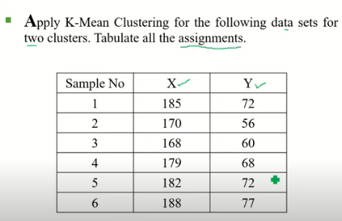
Try it out

Slide 47
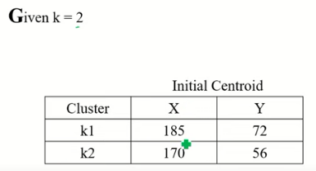
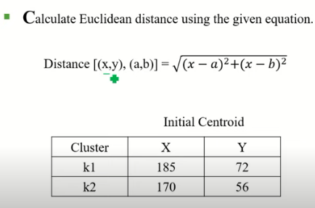

Slide 48
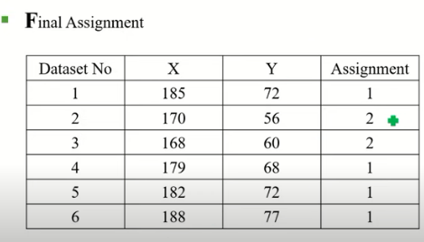

Slide 49
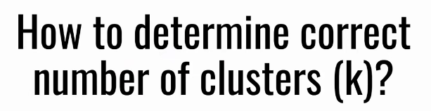
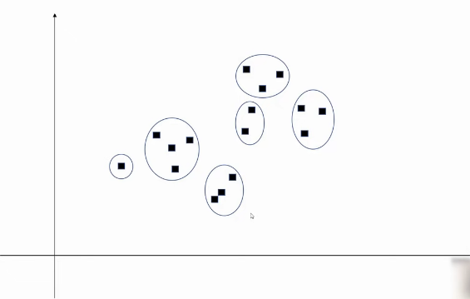

Slide 50
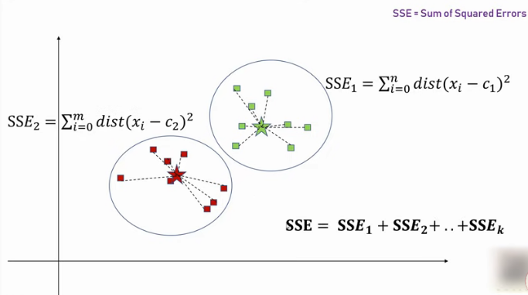

Slide 51
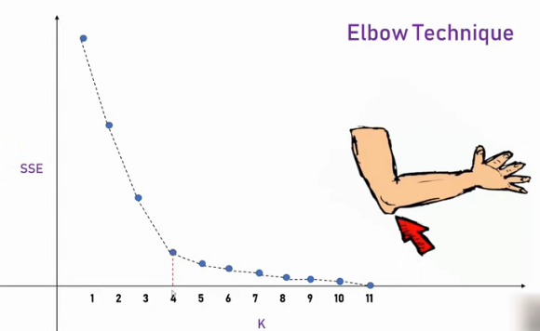

Slide 52
